Slide 1
ELECTRICAL SCIENCE-1 (15B11EC111) UNIT-1 Lecture-7

Slide 2
Topics to be Discussed
Parallel resistors
Current division rule
Numericals
Practice Problems
References

Slide 3
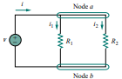

Parallel resistors [1]
Consider the circuit shown in Fig.1, where two resistors are connected in parallel and therefore have the same voltage across them.
From ohm’s law,
…….(1)
…….(2)
Fig. 1

Slide 4



Applying KCL at node a, gives the total current as
…..(3)
Substituting equation (2) into (3), we get,
…..(4)
Where is the equivalent resistance of the resistors in parallel.
…..(5)
…..(6)

Slide 5



…..(7)
The equivalent resistance of two parallel resistors is equal to the product of their resistances divided by their sum.
Note that this applies only to two resistors in parallel.
In eq. (7) if then
The result in equation (5) can be extended to general case of a circuit with N resistors in parallel. The equivalent resistance is
……(8)
Note that is smaller than the resistance of the smallest resistor in the parallel combination.

Slide 6

If then
For example, if four 100 Ω resistors are connected in parallel, their equivalent resistance is 25 Ω.
It is convenient to use conductance rather than resistors when dealing with resistors in parallel.
From equation (8), the equivalent conductance for N resistors in parallel is
Where , , , , …
Thus, the equivalent conductance of resistors connected in parallel is the sum of their individual conductances.

Slide 7
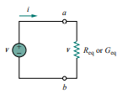

Therefore, the circuit in Fig. 1 can be replaced by Fig. 2.
The equivalent conductance of parallel resistors is obtained in the similar manner as the equivalent resistance of series resistors.
Also, the equivalent conductance of resistors is obtained as the resistance of resistors in parallel.
The equivalent conductance of N resistors in series is
Fig. 2

Slide 8



Current division [1,2,3]
The equivalent resistor has the same voltage or
…….(9)
Combining equations (2) and (9), we get,
……(10)
Thus, the total current, i is shared by the resistors in inverse proportion to their resistances.
This is known as the principle of current division and the circuit in Fig. 1 is known as current divider.
Note that the larger current flows through the smaller resistance.

Slide 9
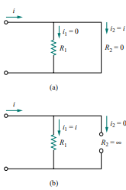
In Fig. 1, suppose one of the resistors is zero, say or short circuit as shown in Fig. 3(a).
From equation (10), implies that , . This means that the current i bypasses and flows through the short circuit , the path of least resistance.
Thus, when a circuit is short circuited, the equivalent resistance,
and the entire current flows through the short circuit.
Fig. 3

Slide 10



Also, as an another extreme case, suppose or is an open circuit.
The current still flows through the path of least resistance, . By taking the limit of equation (7) as , we obtain in this case.
Dividing numerator and denominator by , equation (10) becomes,
Thus, if a current divider has N conductors, in parallel with the source current, i , the n^{th} conductor will have current,

Slide 11
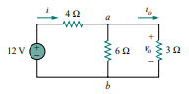
Numericals
Q1. Find i₀ and v₀ in the circuit shown in Fig. Also, calculate the power dissipated in the 3 Ω resistor.

Slide 12
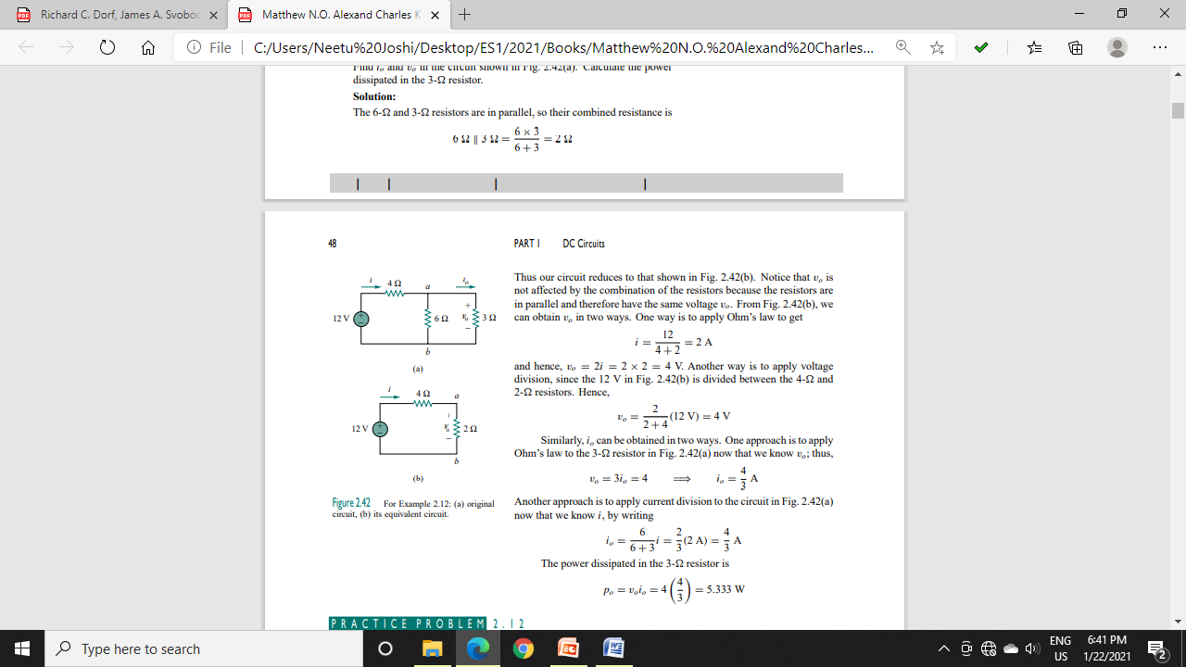
Sol.

Slide 13
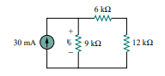
Q2. For the circuit shown in Fig., determine the (a) the voltage, v₀ (b) the power supplied by the current source (c) the power absorbed by each resistor.

Slide 14
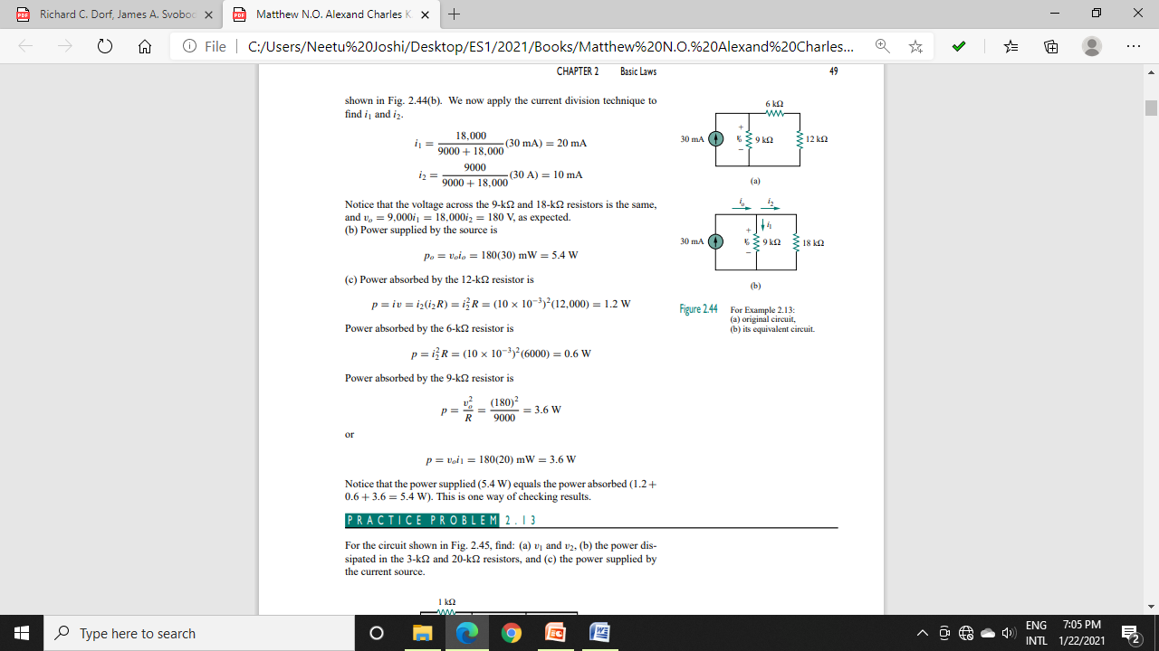
Sol. (a)

Slide 16
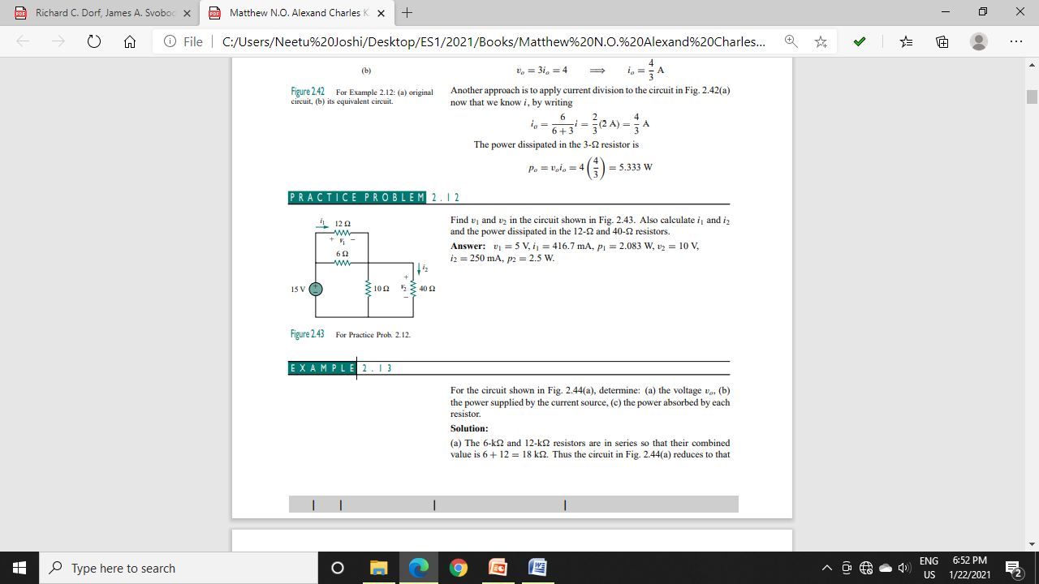
Practice Problems
Q1. Find v₁ and v₂ in the circuit shown in Fig. Also, calculate i₁ and i₂ and the power dissipated in the 12 Ω and 40 Ω resistors.

Slide 18
References
R.C. Dorf and James A. Svoboda, “Introduction to Electric Circuits”, 9th ed, John Wiley & Sons, 2013.
D.C. Kulshreshtha, Basic Electrical Engineering, Revised 1st ed, Tata Mc Graw Hill, 2017.
V. K.Mehta, Rohit Mehta, Basic Electrical Engineering, 6th ed, S. Chand Publishing, 2012.

